Slide 1
Coding Bros
-Mohith Manohar & Manish Manohar

Slide 2
Goal of the final App – Our interpretation
To ensure employees get immediate attention to mental health care but at the same time ensure their ego isn’t hurt => DISCRETION
Key factors to make the app usable:
- Simplicity
- Reward based mechanism

Slide 3
Our proposed solution
CLIENT SIDE:
- Bronze, silver and gold based mechanism to ensure higher reward
for more info shared
- Get the reward and is asked to meet the HR EITHER WAYS
ADMIN SIDE:
- List of all people who require immediate attention
- Schedule appointment in free slots of employees so that it’s a meet
and not an imposition

Slide 4
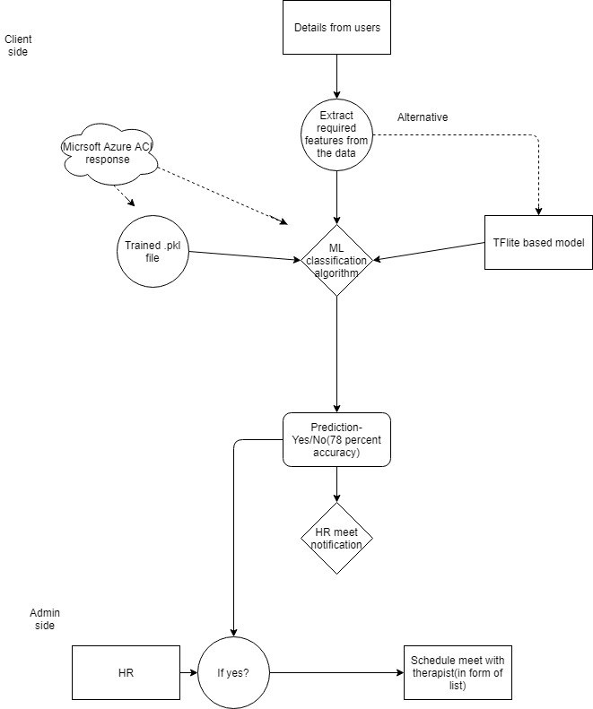
Completed interpretation
Client side UI (Android)
Dynamic firestore db
ML algorithm with 78% accuracy
Trained model(.pkl)
Deployed model on Azure Cloud
Instance

Slide 5
Known faults and future scope
Integration of Model’s outputs with UI based responses
Reason: HTTP timeout for responses from Azure cloud based on ML prediction
Future scope:
Use Text to Speech and Cognitive Speech Services SDK to make the survey user friendly and Voice Assistant based treatment requirement. (making them feel like a person)

